Slide 1
Healthy Hearts: Is it Time for Our data to Move?

Slide 2
Why do we care
Programs get funding based on the quality and impact of their programs
Data analysis and statistics! …
BORING!
Results of these analyses show stakeholders the program is hugely beneficial and deserves more funding…
and this is how employees get paid…
NOT BORING!
And programs continue to expand…
NOT BORNG!

Slide 3
State of storage
Exponential Growth
Multiple Files of same data
Things to consider:
How will our current system

Slide 4
Using spreadsheets

Slide 5
Using databases

Slide 6
What’s important for Healthy Hearts
Minimal access
Only one person (database manager) or a small set of people should have editing rights over the database
Quick reports
However, everybody in the office should have the ability to quickly generate reports from the data in the database
Security
From any outside threats
Remaining HIPAA compliant

Slide 7

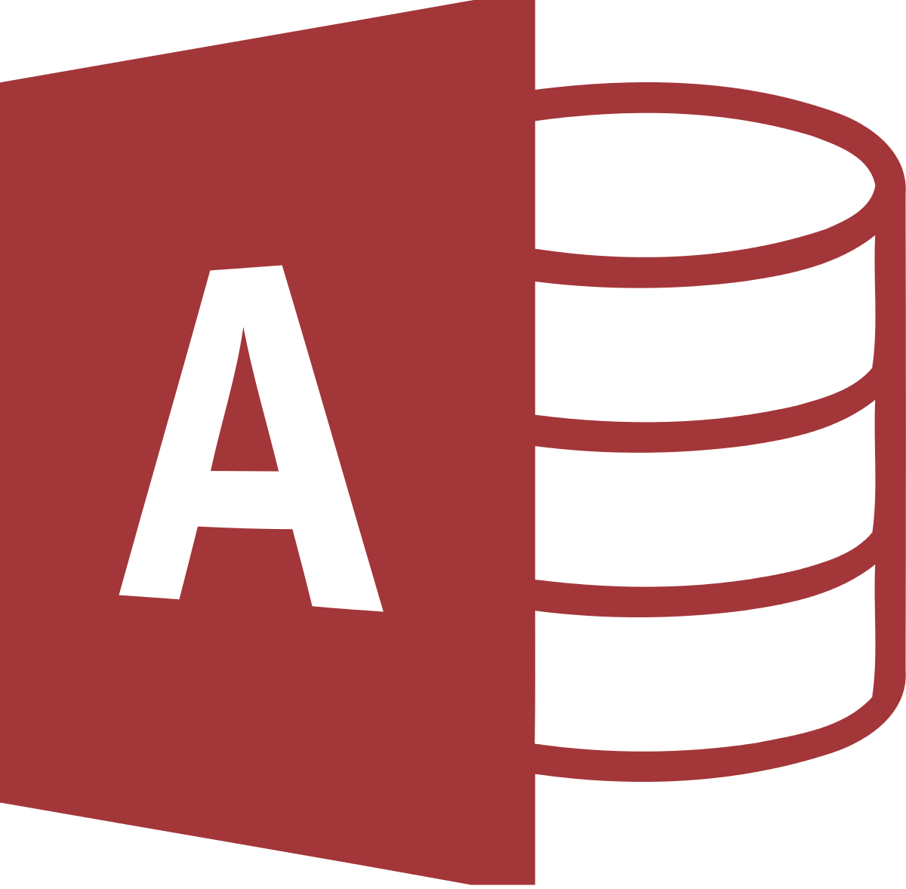
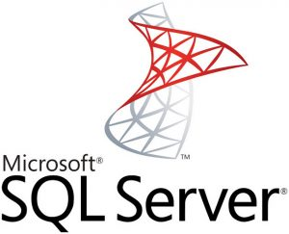
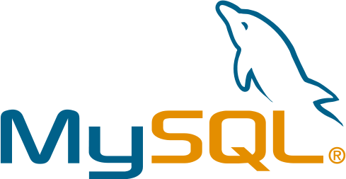
Database Management Systems Available
Microsoft Access
Microsoft SQL Server Express
Microsoft SQL Server
MySQL
Hundreds of others…

Slide 8
Microsoft Access
Fast Facts:
Pre-installed with the Microsoft Suite (should already be on all the machines).
Generally used for very basic, small scale databases.
Easy to use, basically the database focused version of Excel.
Easy integration/migration with pre-existing Excel tables.
Built in forms, reports, other utilities you can use to easily build own databased.
Well suited for non-technical users.
Security: Not secure
Doesn’t support transactional consistency, meaning you can only recover the database to the last full backup .
Reports: Easy to create a variety of reports through use of “wizards”.
Scalability: Not highly scalable, performance issues arise after more than couple thousands of lines of data or more than a handful of users accessing.
Performance: Better than Excel… but only marginally.

Slide 9
Microsoft SQL Server Express
Fast Facts:
Free to download from Microsoft.
Used for small to medium scale applications.
Requires decent amount of technical ability to implement and manage tables.
Security: Secure
Transactional consistency, meaning there is a backup and recovery architecture in place so you could recover to any point in the database’s lifetime if necessary.
Reports: Requires an additional application to act as user-facing interface for reports.
Scalability: Highly scalable, with ability to easily upgrade software later with growing needs.
Supports essentially an unlimited amount of lines and high amount of concurrent users.
Performance: Great, most commonly used enterprise relational database management systems by small to medium sized businesses.

Slide 10
Microsoft SQL Server (Enterprise)
Fast Facts:
Essentially the robust, large-scale business version of Microsoft SQL Server Express
Requires a license for use: ~$900 for open license usage
Used by entities such as the NASDAQ stock exchange, Dell, Yahoo, and Microsoft
Security: Very secure
Transactional consistency, meaning there is a backup and recovery architecture in place so you could recover to any point in the database’s lifetime if necessary.
Reports: Easily able to turn raw data into meaningful reports through the use of various Microsoft plug-ins.
Scalability: Highly scalable, with ability to easily upgrade software later with growing needs.
Supports essentially an unlimited amount of lines and high amount of concurrent users.
Performance: Great, most commonly used enterprise relational database management systems by businesses with very large databases (Terabytes to Petabytes) to manage.

Slide 11
MySQL Enterprise Edition
Fast Facts:
Oracle implementation of an enterprise Relational Database Management Software.
Generally used in large-scale applications where terabytes of data are being stored.
Free and open source
Security: Secure
Non-transactional, more vulnerable to crashes than MS SQL Server.
More difficult to back up data.
Reports: More difficult, requires downloading and learning the use of third-party reporting tools.
Scalability: Highly scalable, similar to Microsoft SQL Server.
Performance: Great, similar to Microsoft SQL Server.

Slide 12
Recommendation
Microsoft SQL Server (Enterprise) and MySQL Enterprise edition are overkill for the requirements of the Healthy Hearts Program
We are not storing anywhere close to Terabytes of screening and testing information
These are highly technical database management systems that would probably require the hiring of an outside contractor to fully implement.
Microsoft SQL Server has a pricey license.
There would be a good learning curve for Austin to become comfortable working in the MySQL environment.

Slide 13
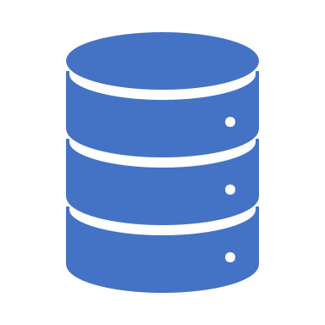
So…
Both seem to meet different needs of the Healthy Hearts Program
Good news, we can use both!
It’s fairly easy and straightforward to use SQL Server Express as a back-end database with Microsoft Access acting as the user-friendly interface where staff can easily generate various reports and exports as needed (without having any edit permissions on the data within the database).
Even better news, the two database management software applications should not cost the program a penny!
If/when the Healthy Hearts Program decides to scale up, if necessary it would be very easy to scale up the SQL Server Express database into a SQL Server Enterprise database.

